Slide 1
FIFA World Cup Analysis

Slide 2
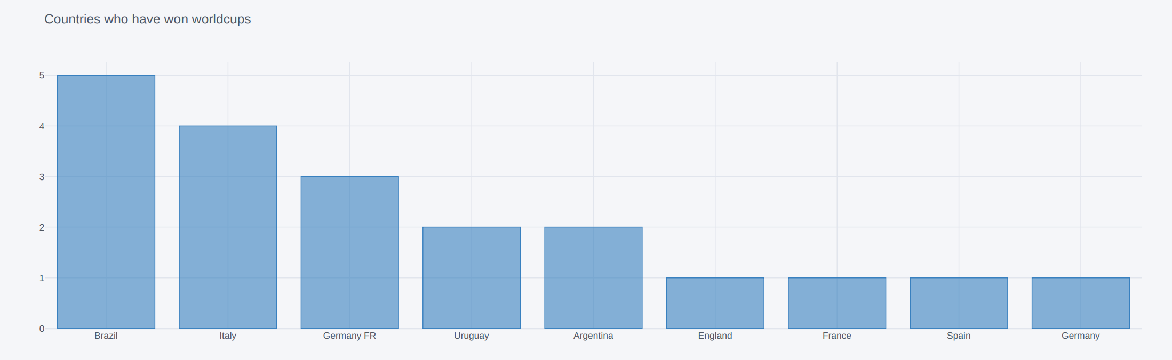
Insight 1 : Brazil has won the tournament most number of times.

Slide 3
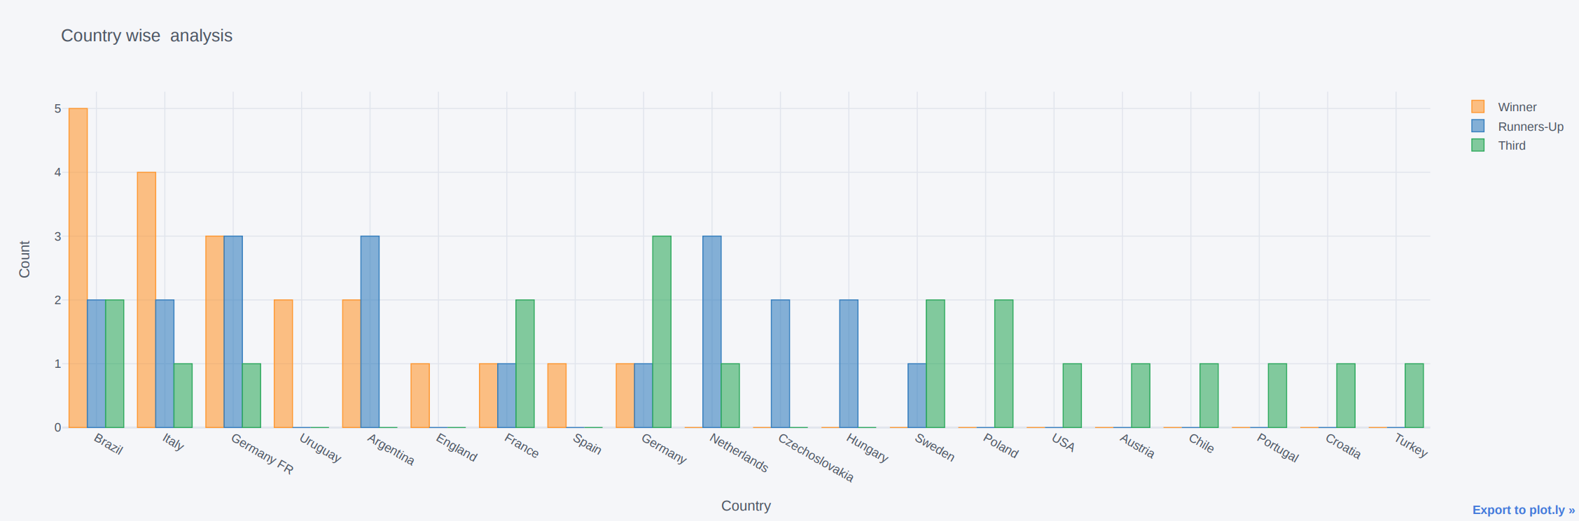
Insight 2 : A complete depection of number of world cups won, first runner-up, and second runner-up positions by various participating teams.

Slide 4
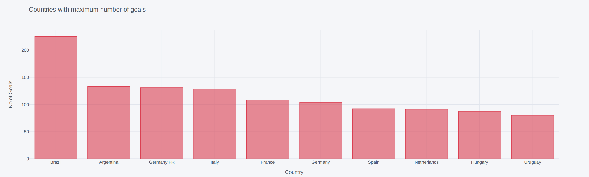
Insight 3 : Brazil scored the most number of goals throughout the history of world cup followed by Argentina and Germany.

Slide 5
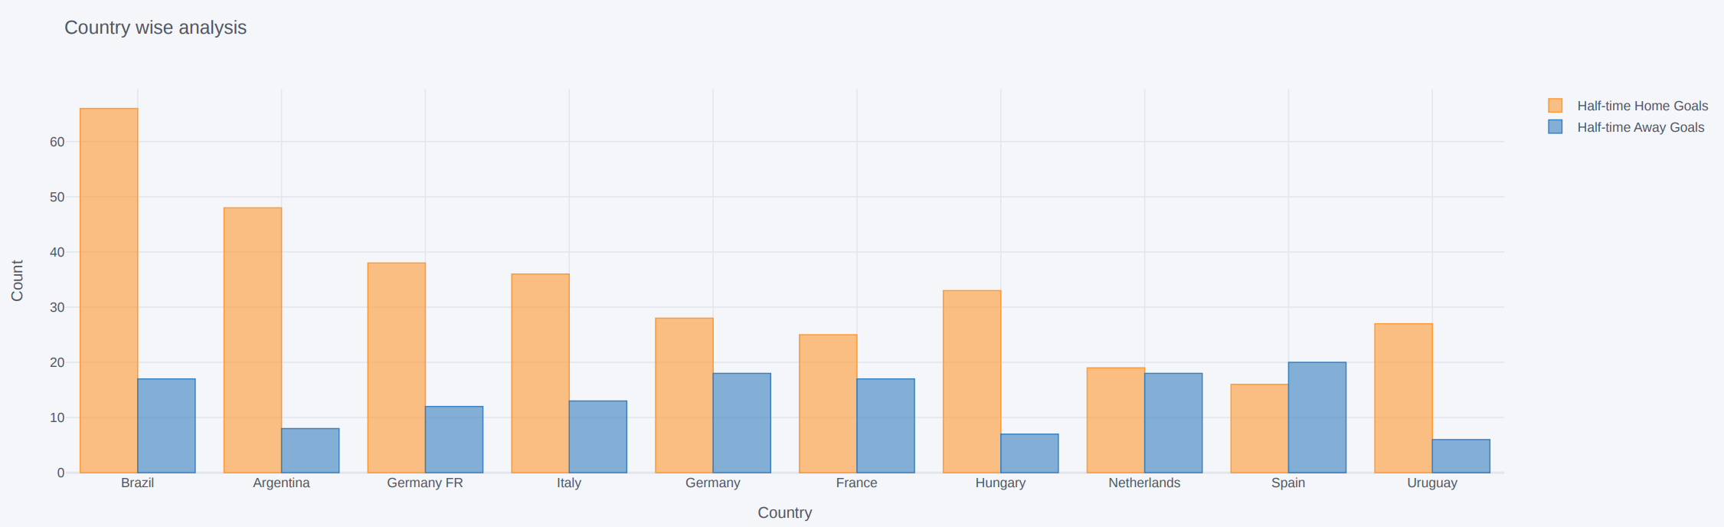
Insight 4 : Brazil has again scored a majority of total goals playing as home team whereas Spain scored more goals playing as away country rather than home country

Slide 6
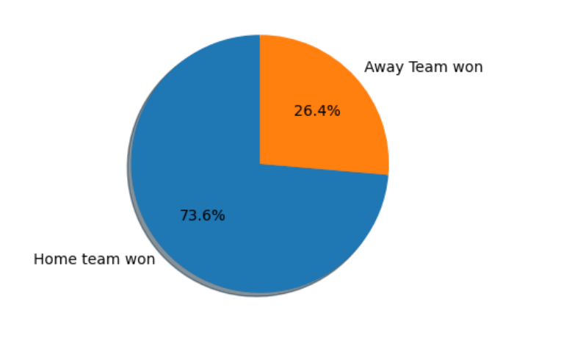
Insight 5 : 73.6 % of the matches were won by home team while 26.4 % were won by away team.

Slide 7
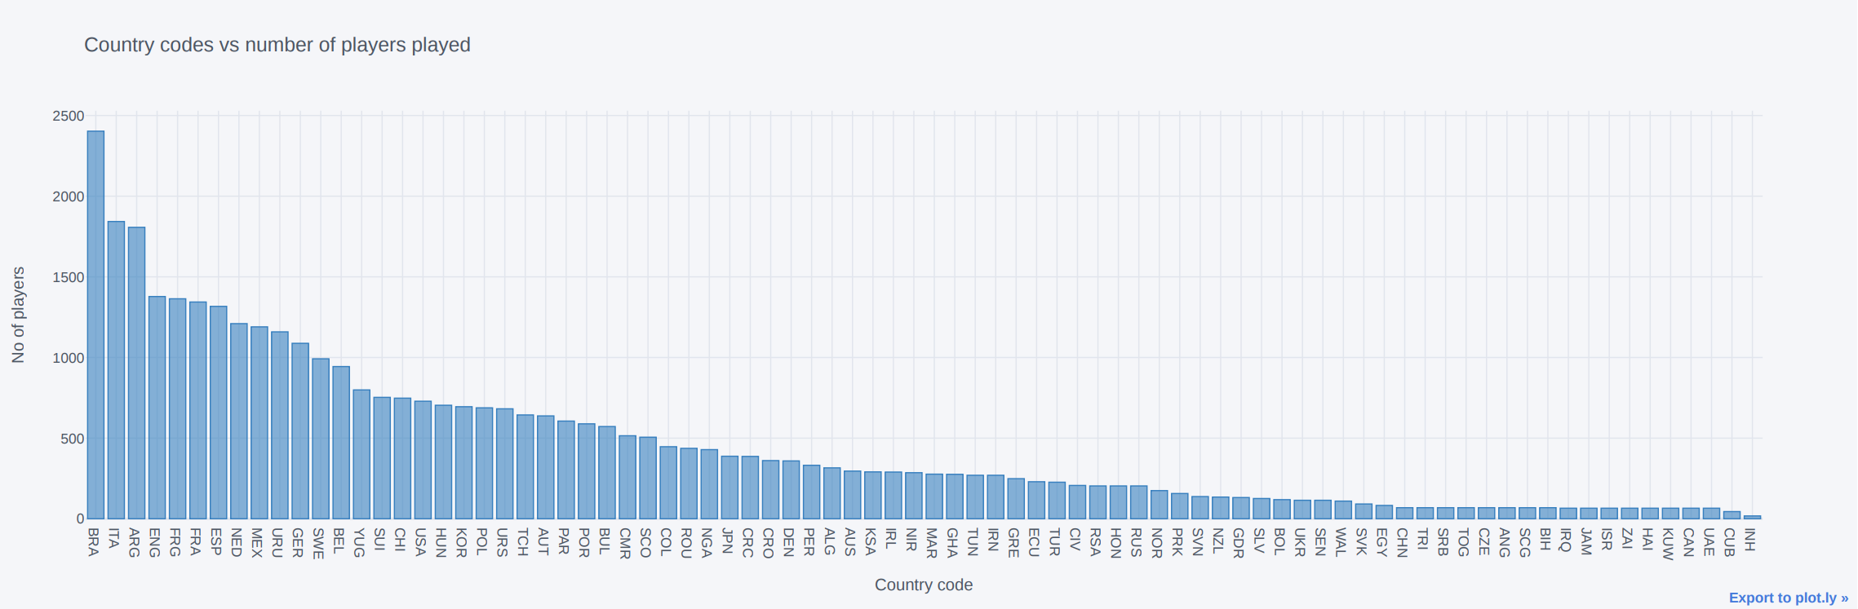
Insight 6 : Brazil has played the most number of players followed by Italy and Argentina

